Slide 1
Predicting Early Diabetes
Using Machine Learning techniques with PySpark
Baitalik Paul• A20009

Slide 2
Index
Project Workflow
Problem Definition
Project Goal
Data set Information
EDA
Data Preparation
Model Building
Evaluation

Slide 3
Project Workflow
Evaluating performance of the model and selecting the best model
Preparing data for model building
Problem Definition/Project Goal
Data collection and exploration
Data preparation
Model building
Model evaluation/Conclusion
The first phase of the workflow includes defining the problem and setting up project goal
Collection of data and checking for validity with EDA
Building different machine learning model using different techniques

Slide 4
Problem Definition
Diabetes mellitus, commonly known as diabetes, is a metabolic disease that causes high blood sugar,which can increase the risk of dangerous complications, including stroke. The hormone insulin moves sugar from the blood into your cells to be stored or used for energy. With diabetes, your body either doesn’t make enough insulin or can’t effectively use the insulin it does make.
There are several factors associated with diabetes apart from family history :
Smoking
Hypertension
Age
High BMI etc.
In this project we will try to predict chances of Diabetes considering few health factors.

Slide 5

Project Goal
We will consider Diabetes as our target variable
We have a historic dataset containing Diabetic and non-Diabetic patients with their individual health parameters . We will build predictive models using machine learning technique using the data set.
Find the best model among the test models which will help us to predict whether a person is dibetic prone or not by considering few individual health factors so that the person can take proper measures to avoid future Diabetes.

Slide 6
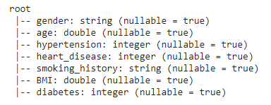
Data Set Information
Independent Variables
Age
Gender : Male,Female,Other
Hypertension : ‘1’ for yes ‘0’ for no
Heart Disease History : ‘1’ for yes ‘0’ for no
BMI : Body Mass Index is a person's weight in kilograms divided by the square of height in meters. High BMI indicates overweight and low BMI indicates underweight
Smoking History : Not current , Current , Former , Ever , Never
Target Variable
Diabetes : ‘1’ for yes ‘0’ for no

Slide 7
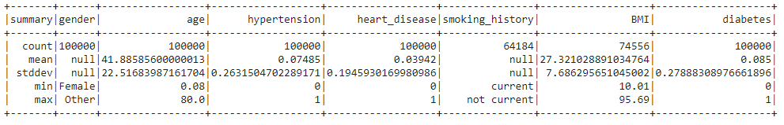
Exploratory Data Analysis (descriptive)
This is helpful for numeric variables mainly , we can see from the output that
For AGE : mean age is around 41 with standard deviation 22 so mainly we have aged people here with maximum age 80
Hypertension ,Heart Disease and Diabetes are in binary format
BMI : mean value is around 27 which is slightly more than the normal (18.5 – 24.9)with standard deviation 7 .
Gender and Smoking History are categorical so we can not interpret them here properly .

Slide 8
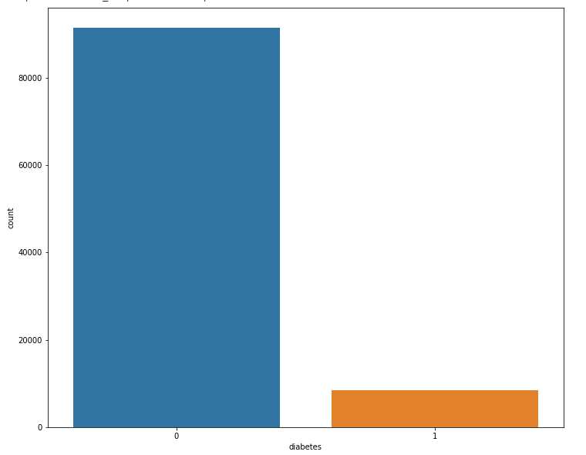
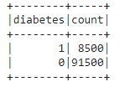
Exploratory Data Analysis (spark.sql)
The data set has 100000 row and 7 columns
Number diabetic and non-diabetic
So number of non-diabetic patients (‘0’) in more compared to diabetic patient (‘1’)

Slide 9
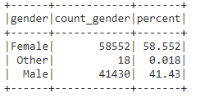
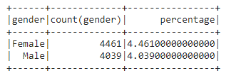
Exploratory Data Analysis (spark.sql)
Number of female and male patients in the dataset , there are few instances with gender as other as well
Number of female and male patients who has diabetes ,almost same number of female and male has diabetes , so we can conclude that this disease has no connection with gender

Slide 10
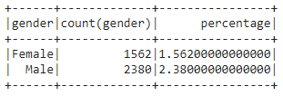
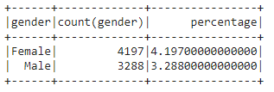
Exploratory Data Analysis (spark.sql)
Number of female and male patients having heart disease, we can see that number of male patients having heart disease is more compared to female .
Number of female and male patients who has hypertension, in this case number of female patients is more compared to male patients , so female patients are having more hypertension issues than male

Slide 11
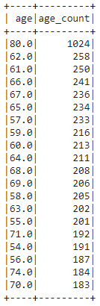
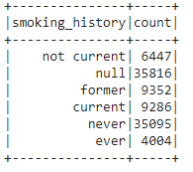
Exploratory Data Analysis (spark.sql)
Count of different types of smoker,this contains a good number of null values we have to deal with it in later stage
Age vs number no patients who has diabetes, from the data we can see that as the age is decreasing the number of diabetic patients is also decreasing , age has positive relationship with diabetes .
This indicated that older people are more diabetic prone
Out of 7480 diabetes patients 6650 are over 50 age .

Slide 12
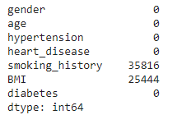
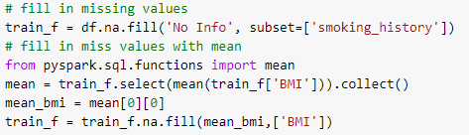
Data Pre-Processing (Null Operation)
Checking Null values
For Heart diseases we fill the null positions with ‘No Info ’
For BMI we will compute the mean value and replace the null values with the mean
Only BMI and Heart diseases have null values ,BMI is a numerical variable and Heart Disease in categorical

Slide 13
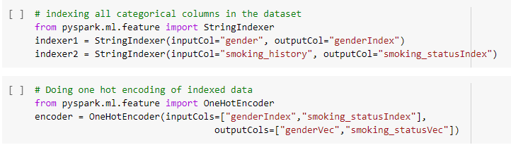
One Hot Encoding (for categorical variable)
One hot encoding is a process by which categorical variables are converted into a binary form that could be provided to ML algorithms to do a better job in prediction
Gender and smoking history are categorical variables , so we have to encode only these two . we have used VectorAssembler,OneHotEncoder and StringIndexer module from ‘pyspark.ml.feature’ library .

Slide 14
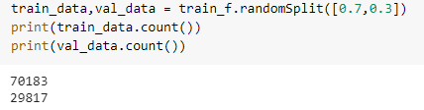
Train-Test Split
The train-test split is a technique for evaluating the performance of a machine learning algorithm.The procedure involves taking a dataset and dividing it into two subsets.
Train Dataset: Used to fit the machine learning model.
Test Dataset: Used to evaluate the fit machine learning model.
We have split the data into 7:3 ration so 70 % of the data will be used to train the model (train_data) and 30% of the data will be used to test the model (val_data)

Slide 15
Building Machine Learning Model
We have created pipelines for different models :
A machine learning pipeline is used to help automate machine learning workflows. They operate by enabling a sequence of data to be transformed and correlated together in a model that can be tested and evaluated to achieve an outcome, whether positive or negative.
We have used below machine learning techniques :
Logistic regression (Linear Model)
Random Forest (Ensemble Model)
Gradient Boost (Ensemble Model)
Ensemble modeling is a process where multiple diverse models are created to predict an outcome, either by using many different modeling algorithms or using different training data sets. The ensemble model then aggregates the prediction of each base model and results in once final prediction for the unseen data.

Slide 16
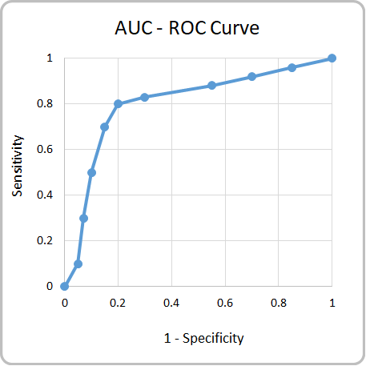
Evaluation Metrics
We will use two evaluation methods to measure the performance of our model
Accuracy : Model accuracy is defined as the number of classifications a model correctly predicts divided by the total number of predictions made.
AUC : AUC stands for "Area under the ROC Curve." it measures the entire two-dimensional area underneath the entire ROC curve. AUC provides an aggregate measure of performance across all possible classification thresholds. In the picture a area under the blue curve is AUC score
As our data set is imbalance and this is a classification problem so we will more focus on AUC score

Slide 17
Model Evaluation
Logistic Regression
Accuracy : 91.27 %
AUC Score : 0.79 %
Random Forest
Accuracy : 91.27 %
AUC Score : 0.81%
Gradient Boost
Accuracy : 91.46 %
AUC Score : 0.83 %
If we look at the Accuracy score there is no significant changes happen when we have used ensemble models but look at the AUC Score , a significant change has been observed in case of ensemble techniques and highest for Gradient Boost .
This is a classification problem and our dataset is imbalance so we will more rely on AUC Score . We can conclude that the performance of Gradient Boost model is the best among the tested models .

Slide 18
Conclusion
The accuracy of Gradient boost model is 91.46 % so for 100 cases it can correctly predict 91.46 instances also the AUC score is highest for this , so this model will be our final model
Our project goal was to build a predictive model to predict future chance of diabetes depending upon individual health factors and it looks like we have successfully created one with a satisfactory performance score

Slide 19
Conclusion
After deploying the model if a person provide his/her health details the model will suggest whether he/she is diabetic prone or not ,this way one can take necessary measures to avoid diseases like diabetes which will eventually increase life expectancy and will save a lot of money
Overall this project will help to increase health awareness among individuals and help them to adopt healthy practises

